Slide 1

Kearns School Apartments
Tim Bobroske Construction Services LLC
Fiscal Wisdom Holdings, Inc

Slide 2
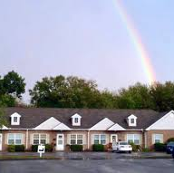
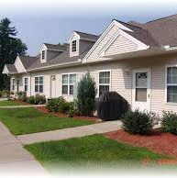
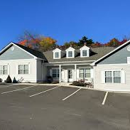
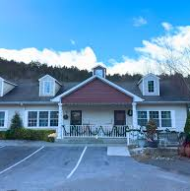
Tim Bobroske Construction Services LLC
A state certified women owned business, creating active independent adult communities.
Quail Hollow
Stone Ridge
Canterbury Village
Thomaston Valley Village
Notes:
First, I would like to introduce ourselves. We are the Tim Bobroske Construction Services LLC. We are a women owned business the specializes in curating active adult communities. To date, we have completed four pertinent developments that demonstrate our expertise in the area of active adult communities.

Slide 3
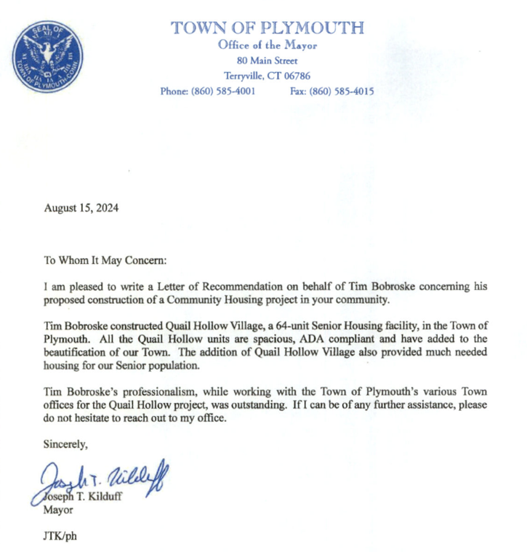
Quail Hollow in Terryville is a 78-unit retirement community we built from scratch, which has community gardens, a pond and a walking trail.

Slide 4
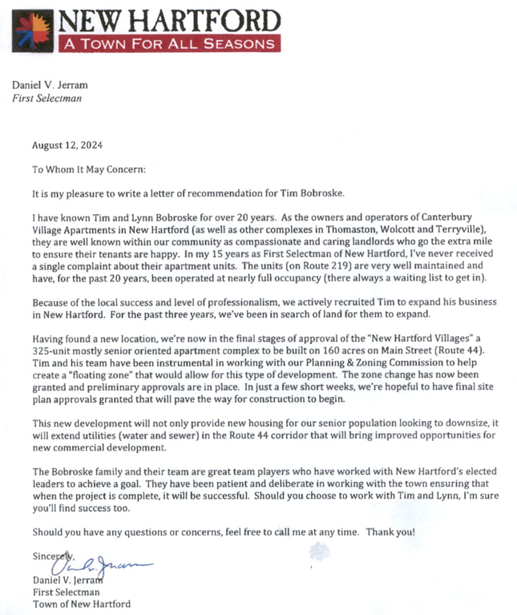
Canterbury Village in New Hartford is a 24-unit retirement community with gardens and is located adjacent to the Farmington River walking trail and access to fishing and tubing on the river. We’re currently working through zoning in New Hartford for a large addition, which is 7 phase, 320 unit addition to this retirement community. This will become our signature property, and this development will be built to include gardens, a fruit orchard, a pond, walking trails, a community room, and a 15,000 square foot grand Lodge for events and parties for community members exclusively.​

Slide 5
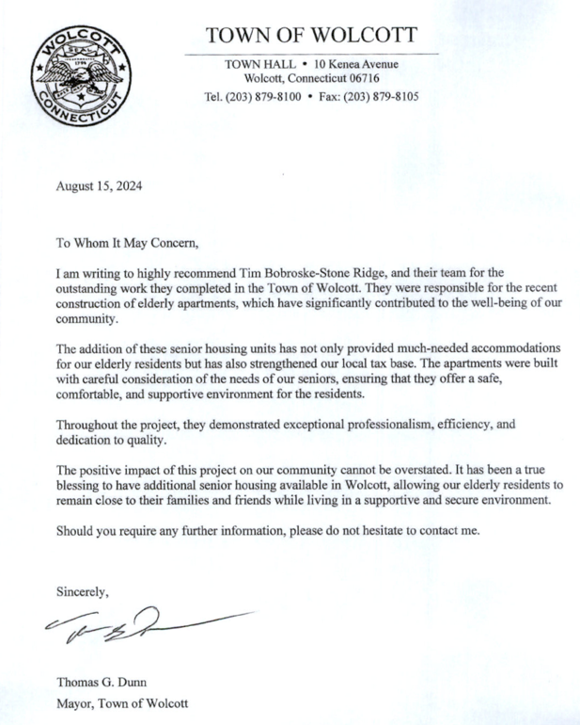
Stone Ridge is a 28-unit retirement community where we’re currently adding 38 more units to it that are under construction right now, which also has gardens and two storm retention ponds for stormwater management as well as additional natural habitat for animals and walking trails. Total Size of property is 66 units

Slide 6
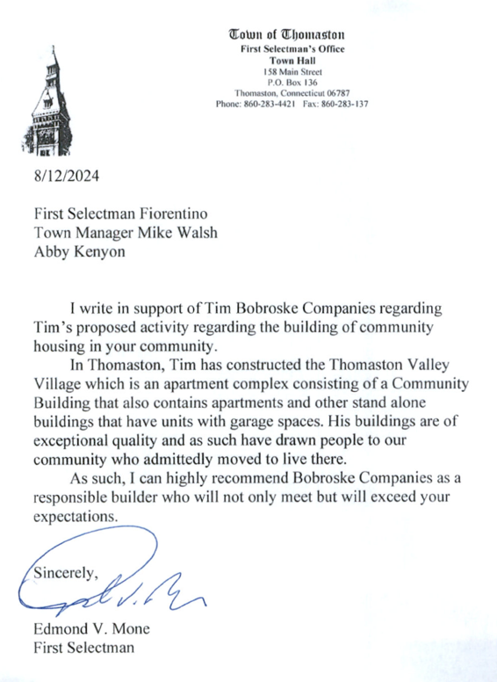
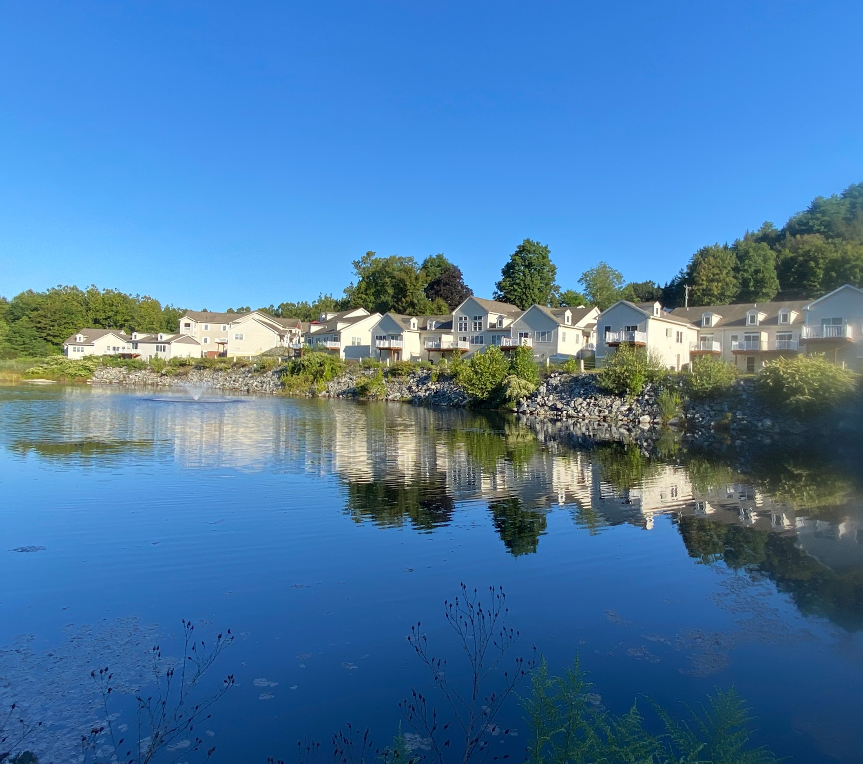
Thomaston Valley Village is a 58- unit retirement community we also built from scratch, and it includes a pond with a walking trail around it, gardens, tenant garages, and a community gathering center for community activities and recreation. ​

Slide 7
Thomaston Valley Village - from the pond

Slide 8
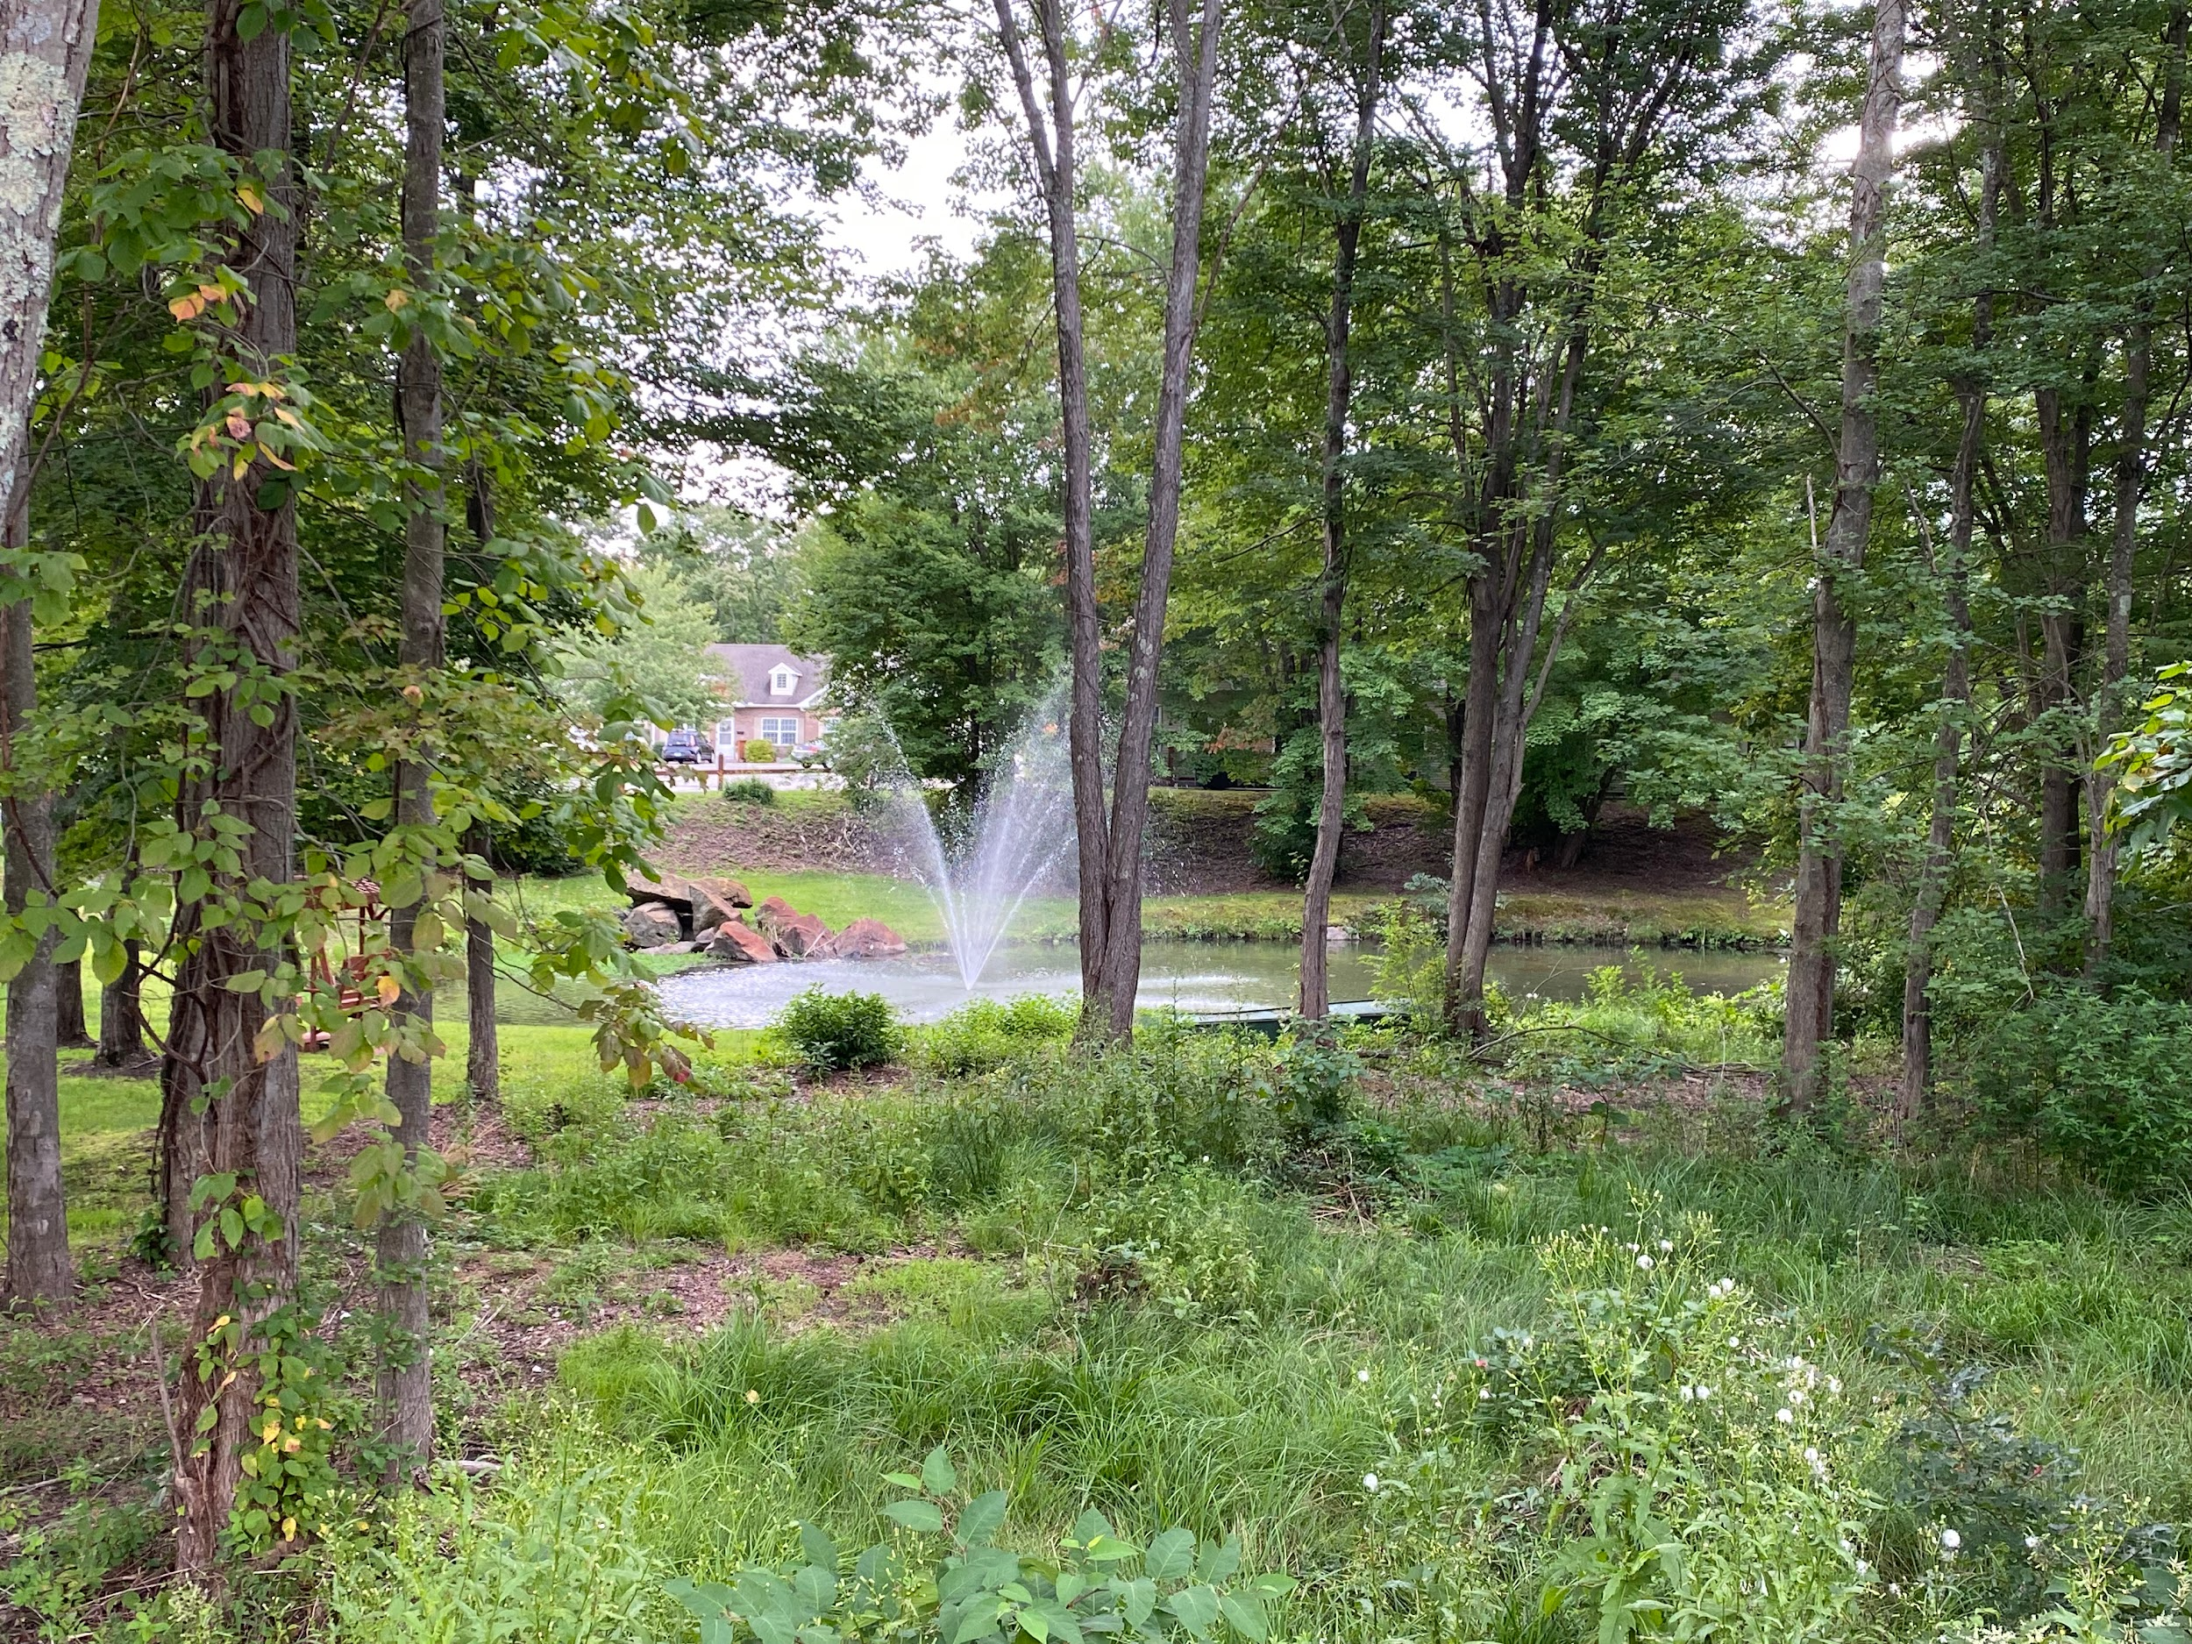
Quail Hollow Village From the Pond

Slide 9
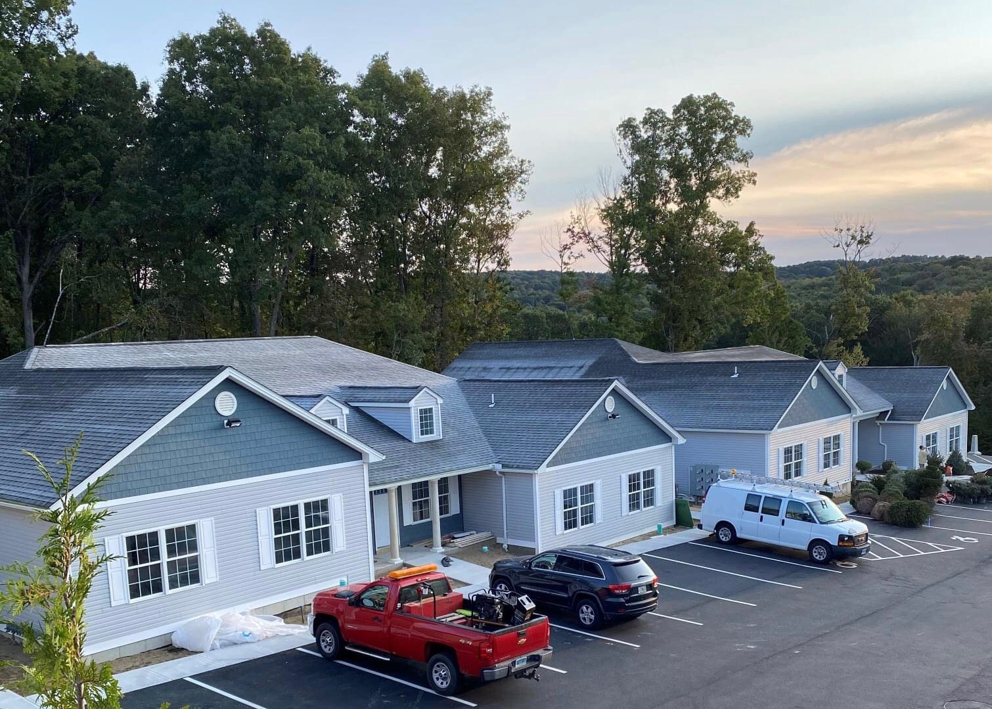
Resident of Stone Ridge in Wolcott - from the drone

Slide 10
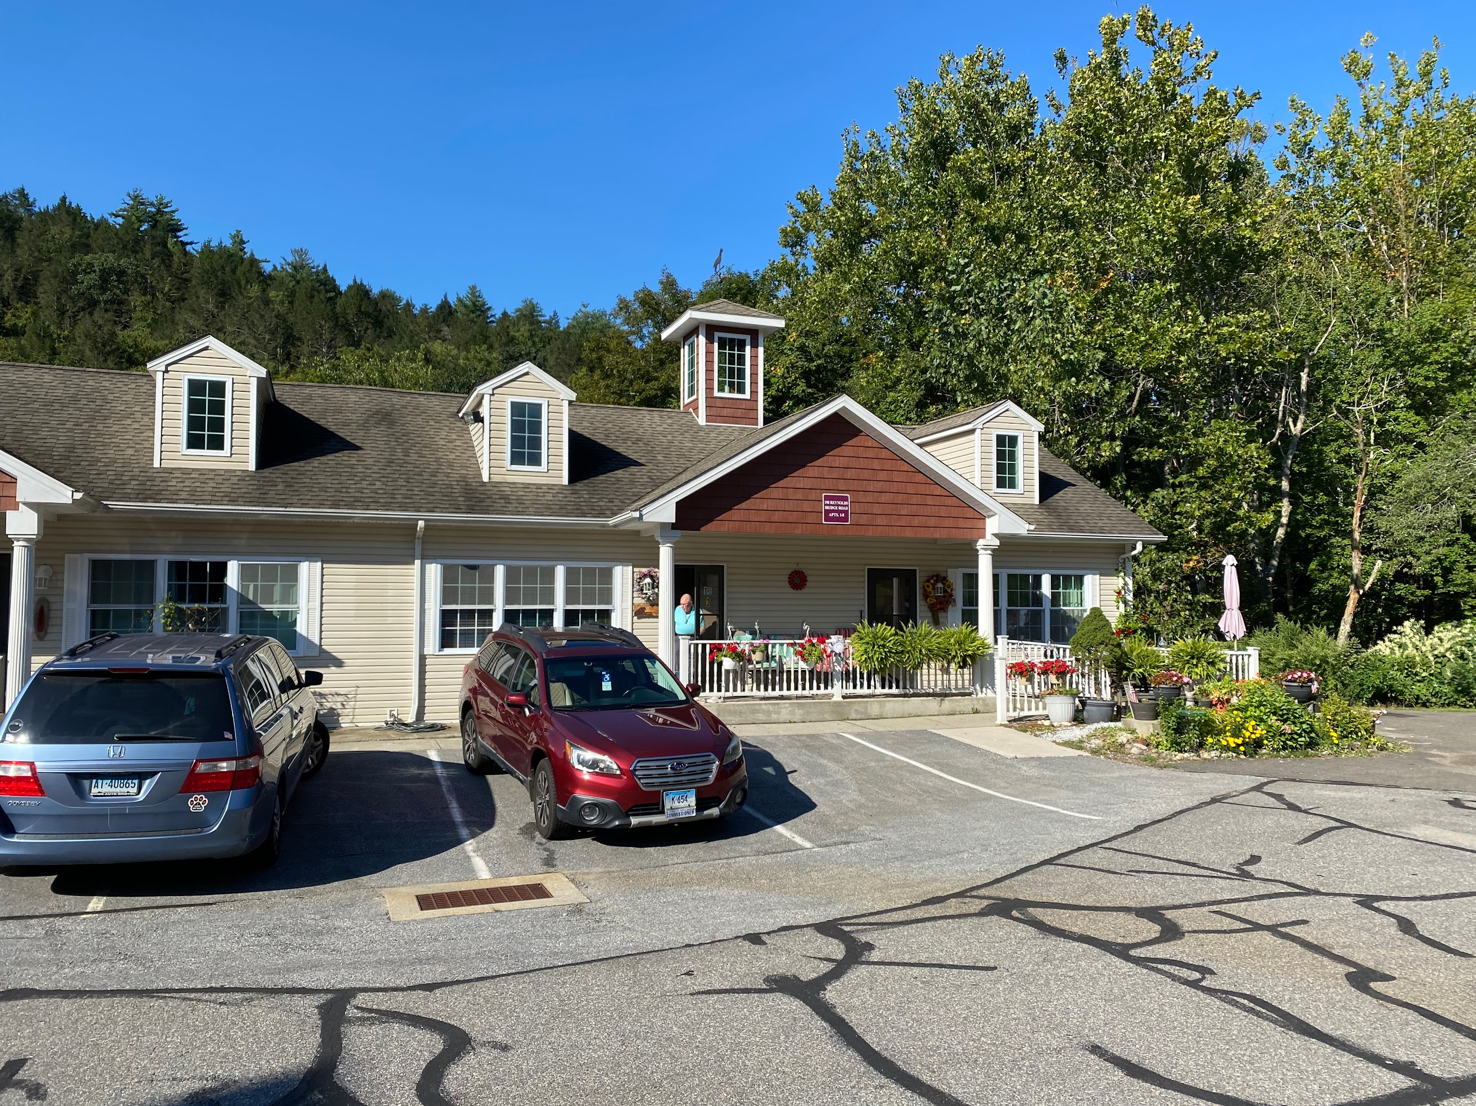
Thomaston Valley Village from the parking lot

Slide 11
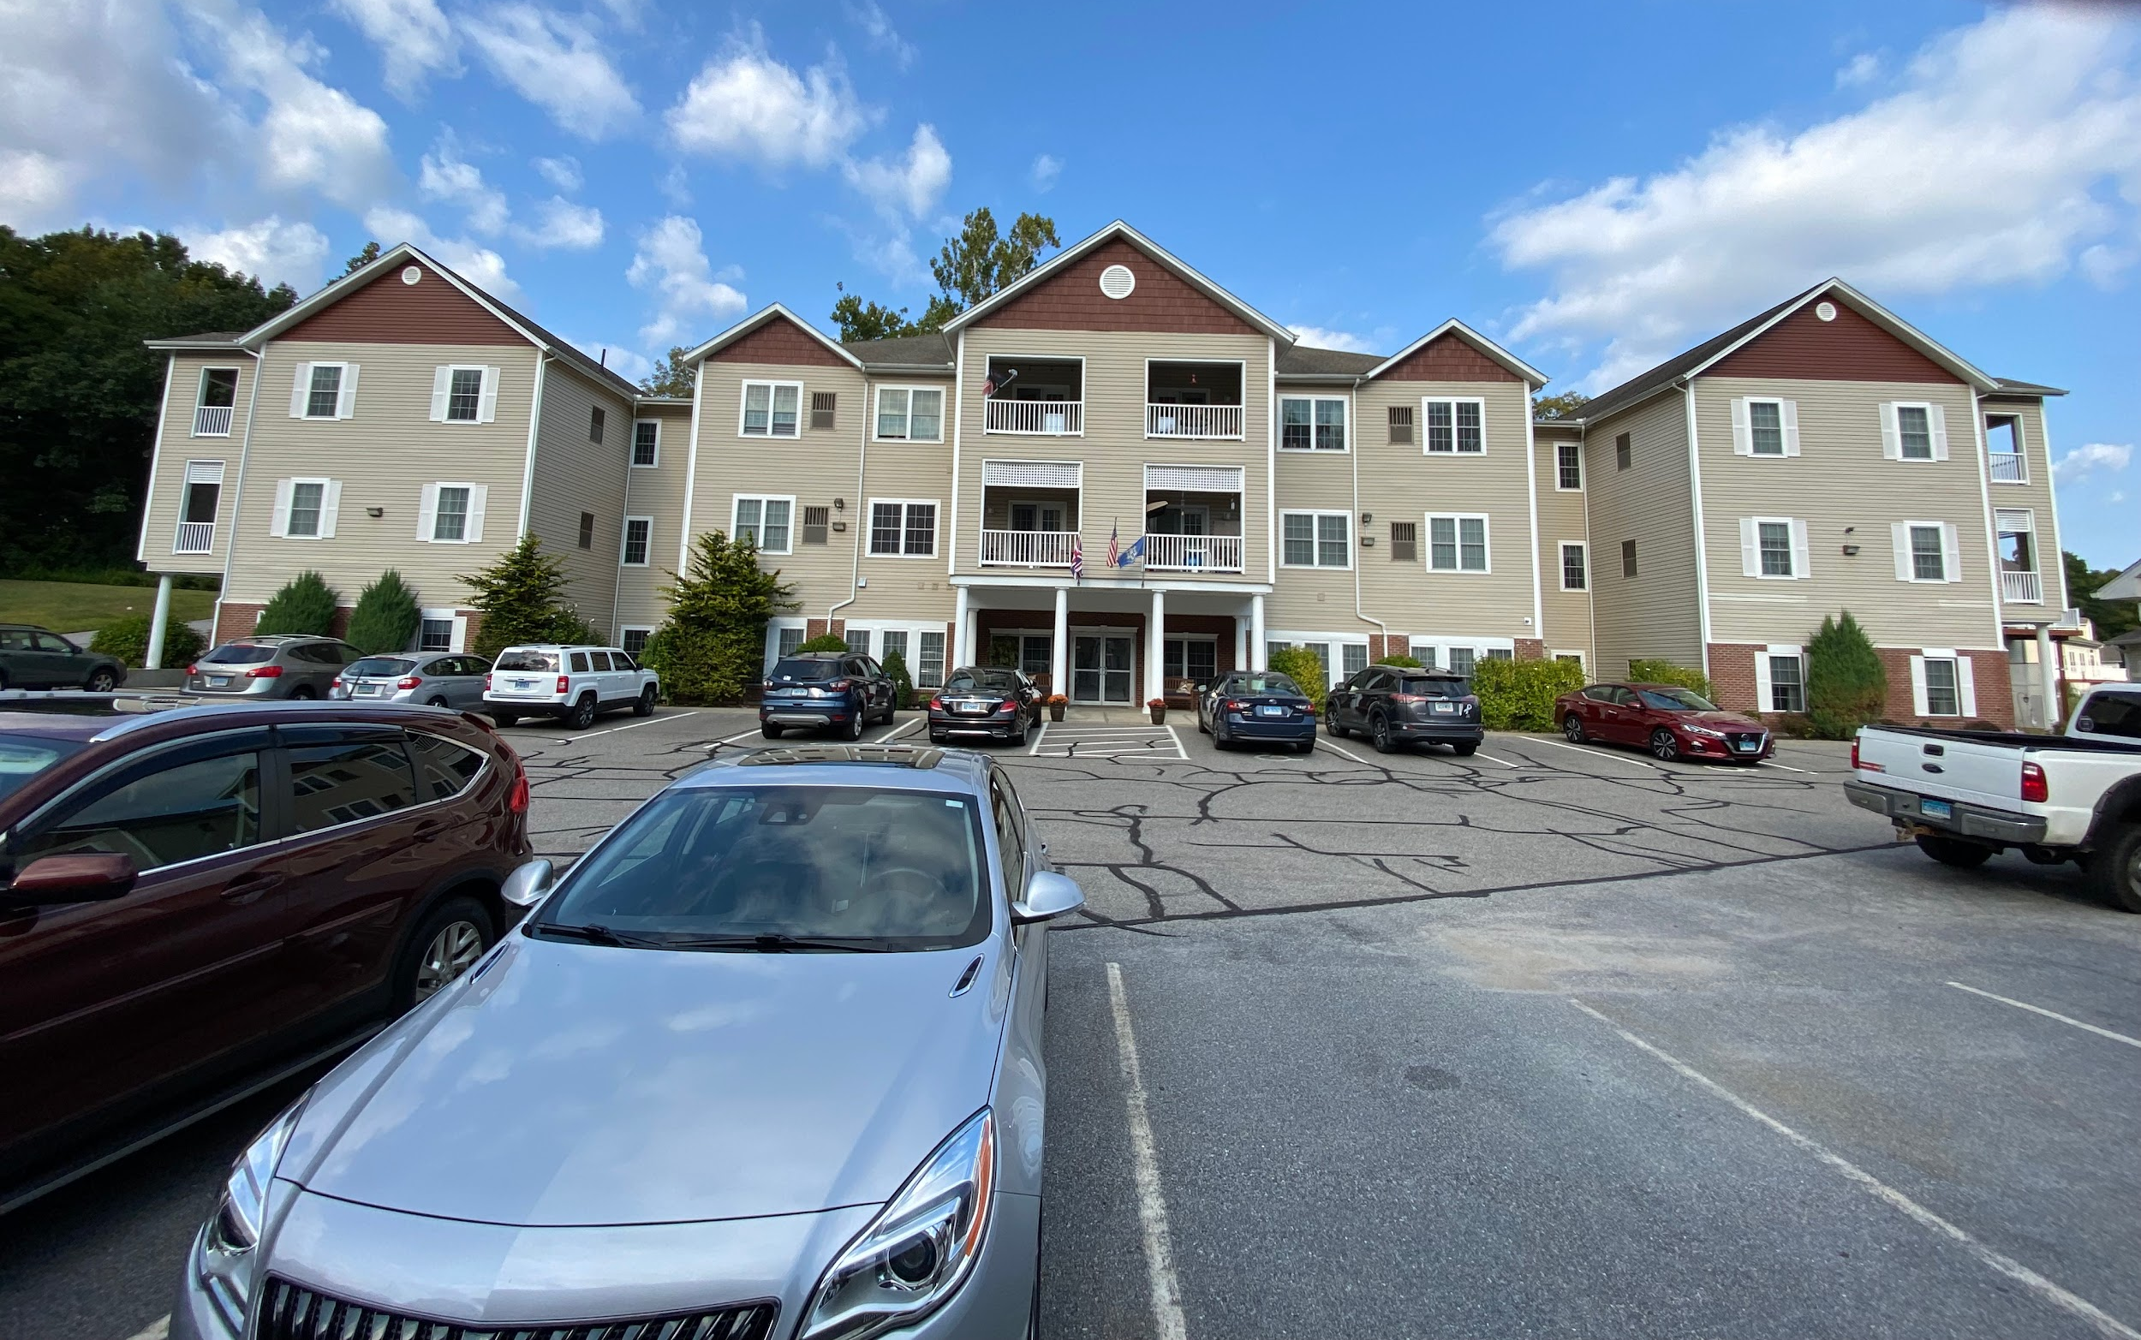
Thomaston Valley Village ( 3 Story Apartments) from the parking lot

Slide 12
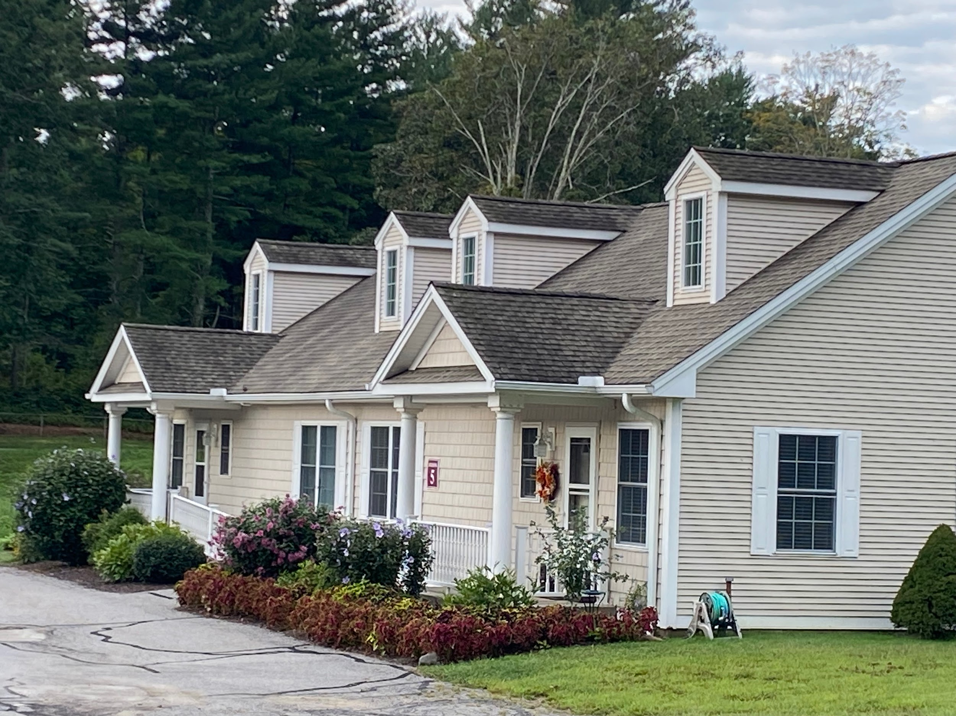
Canterbury Village in New Hartford from the Parking Lot

Slide 13
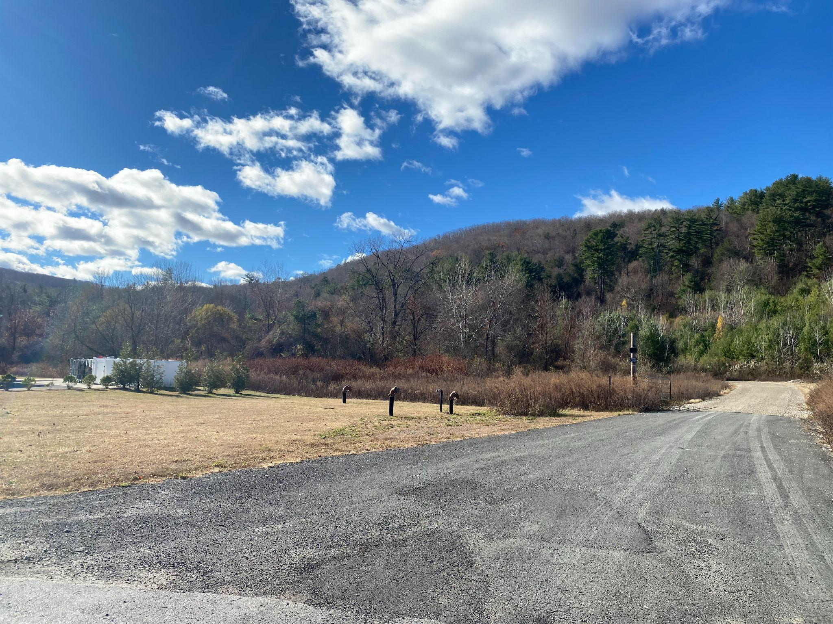
Current Projects
New Hartford Village Addition
320 additional units underway
Future Signature Property
3 out of 4 permits approved
7 phases of development
Mixed senior affordable and market rate housing
Notes:
I will additionally provide a brief overview of our ongoing projects. Our team is currently working on zoning for a 7 phase, 320 unit addition to our Canterbury Village Retirement Community. This will become our signature property, and will include gardens, a pond, walking trails, a community room, and a 15,000 square foot grand Lodge for events and parties for community members exclusively

Slide 14
Background of Firm & the Team
Tim Bobroske
Mike Chadwick
Todd Clark, land surveyor
Wayne Zirolli, PE Civil Engineer
Clint Webb, Environmental Scientist & Consultant
Michael Lambert, P.E, Storm Water Management
Ashley Clark Kidd, Blue Moon Collaborative Architectural
Mark Ziogas, Land Use Attorney
Matt Szydlo, Structural Engineer

Slide 15

Kearns School Apartments
A modern, green, and zero carbon neutral active lifestyle community utilizing solar heat pumps
Notes:
Our Team has a innovative and unique vision for the Kearns School which promises to honor the schools history, while providing an eco friendly and active adult lifestyle community.

Slide 16
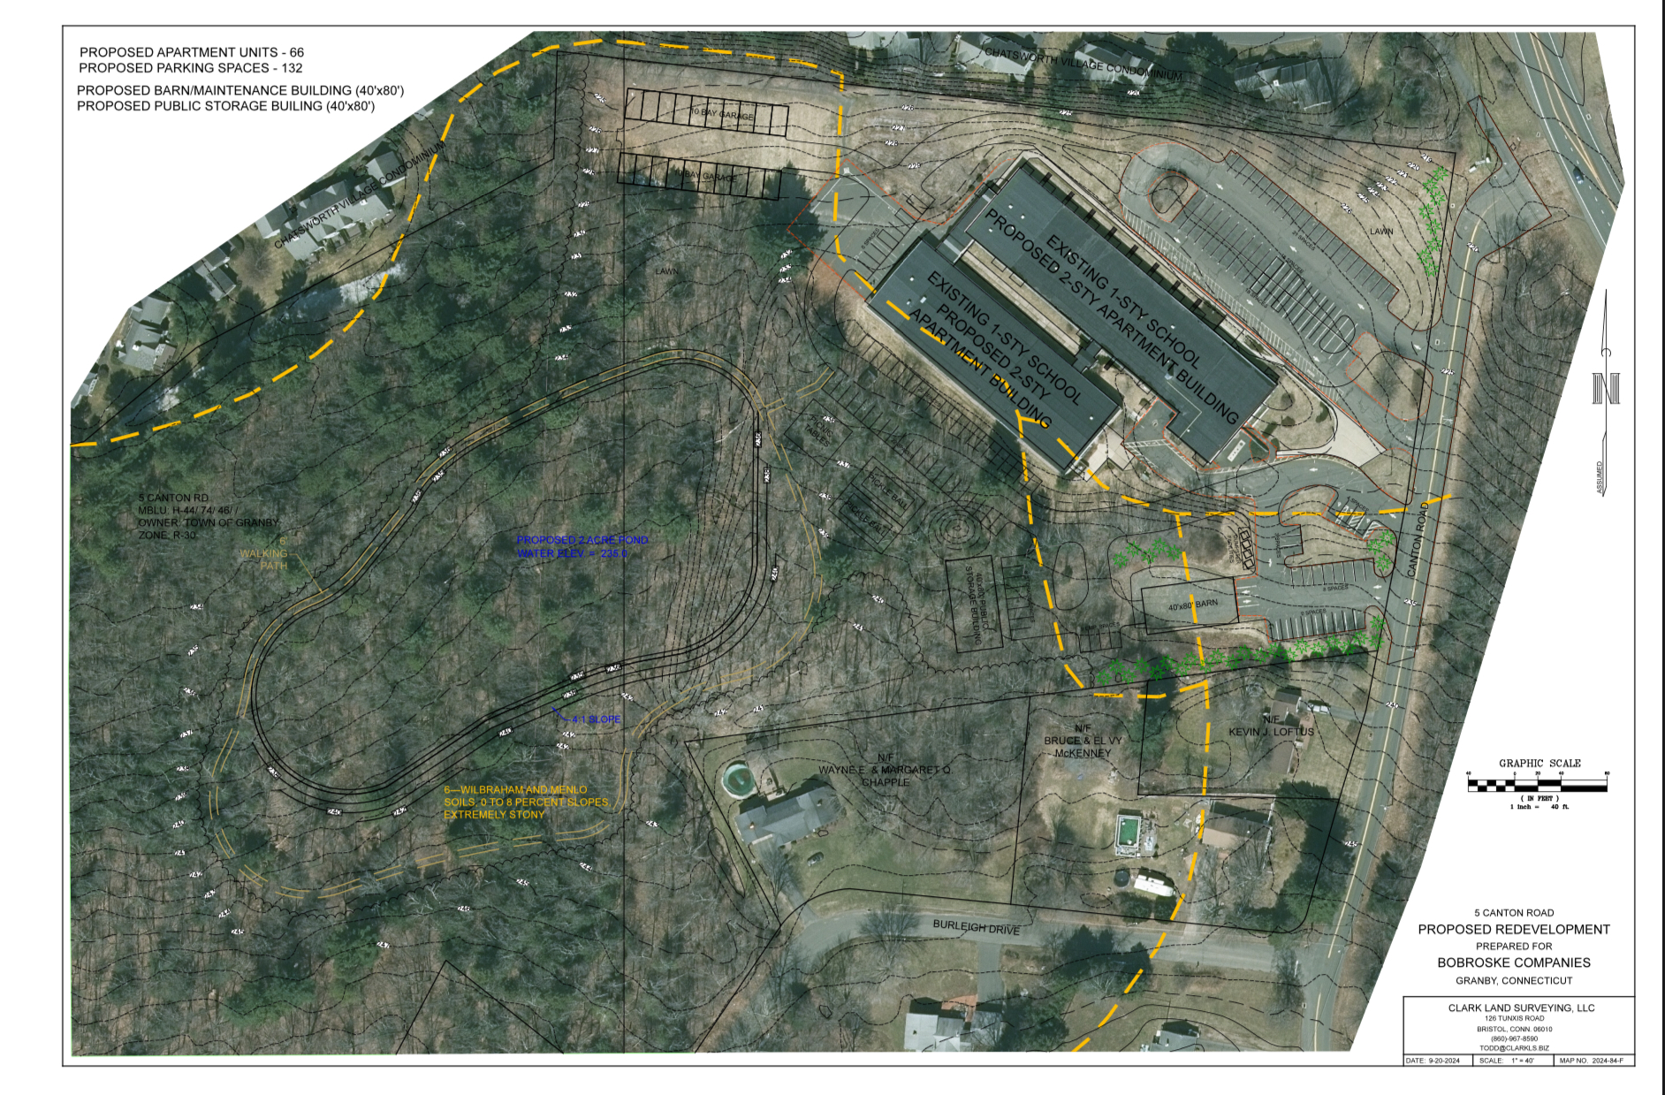
The Property and the Vision

Slide 17
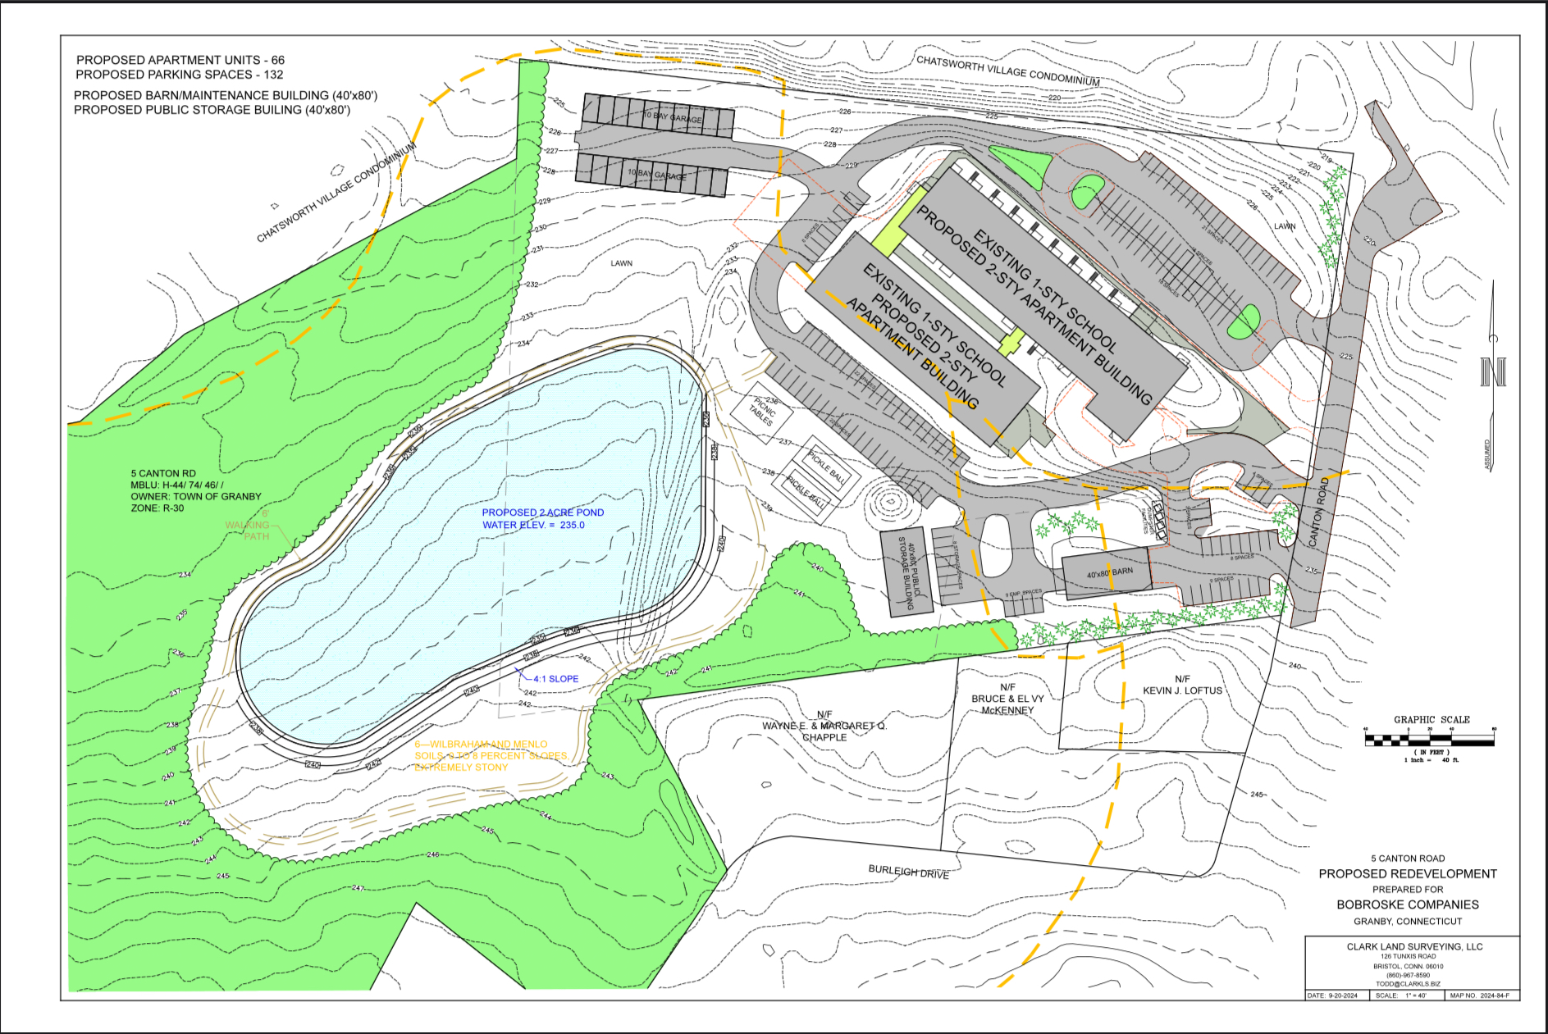

Slide 18
Plans for the Wetlands
In our due diligence reviewing Granby’s inland and wetlands regulations
We propose a water feature - a walking pond
We would support
  Aquatic life
  Plant and animal life
  Animal habitats, nature preserve
  There will be a boardwalk around the pond
  We’d allow fishing for campus residents
Tim has been serving as an inland and wetland town commissioner for the town of Harwinton for the past 19 years.
We’ve done this in four other towns, Clint Webb can talk more about this.
Notes:
Specify age or mixed ages proposed

Slide 19
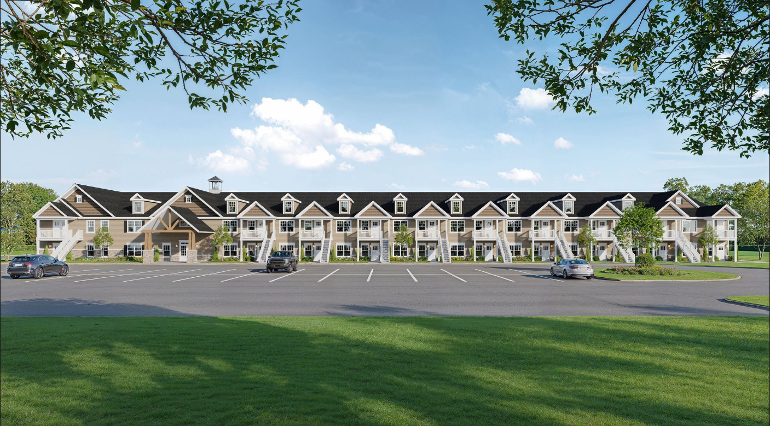

Slide 20
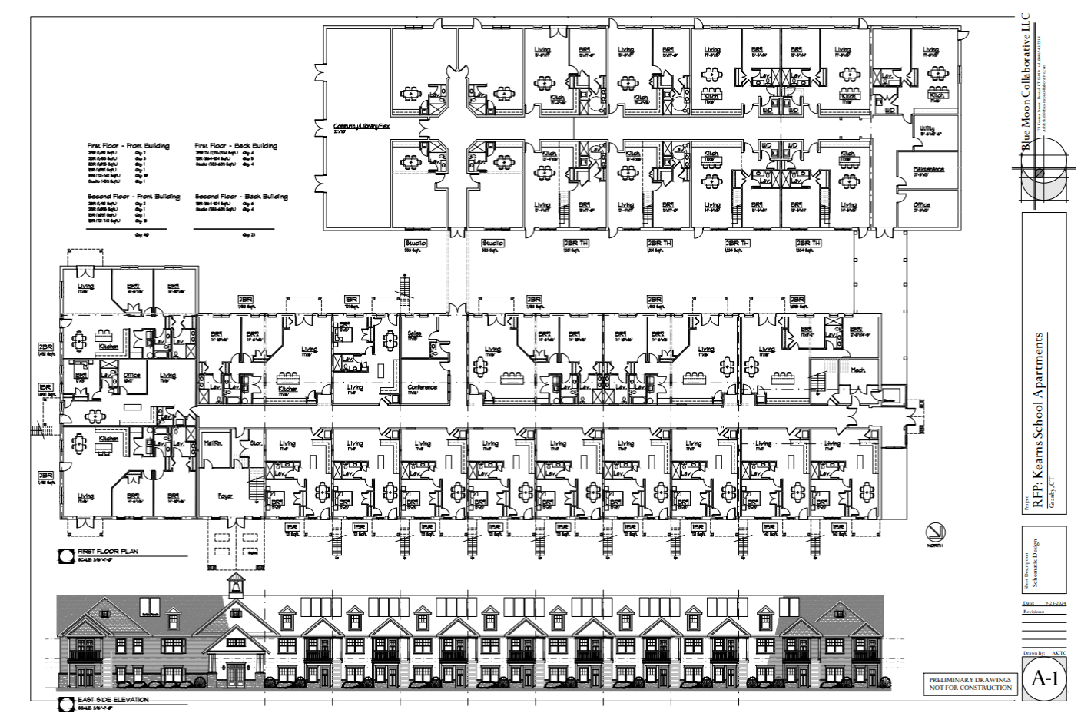

Slide 21
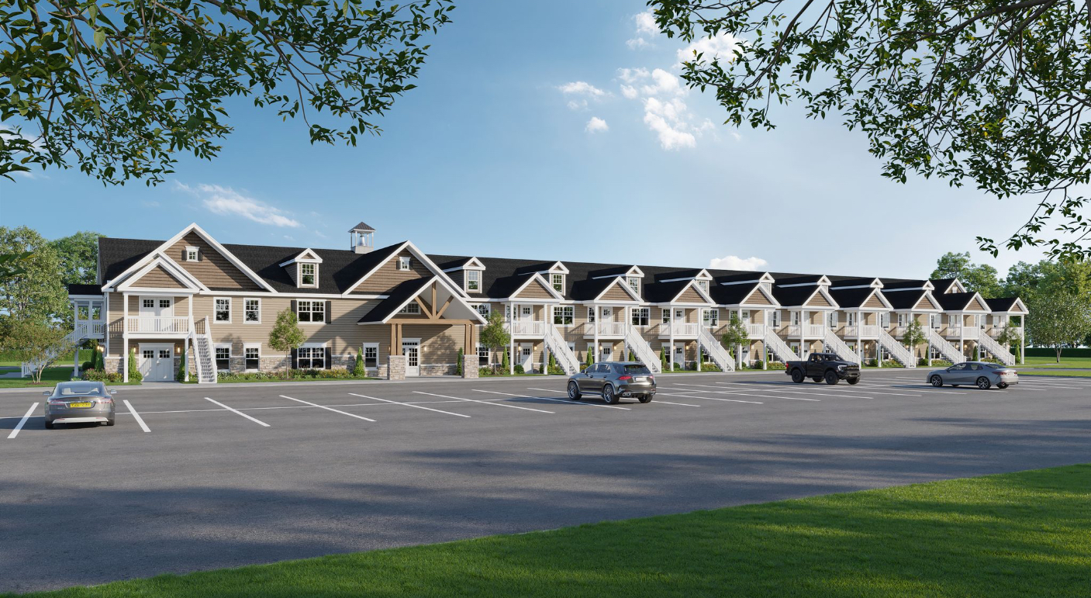

Slide 22
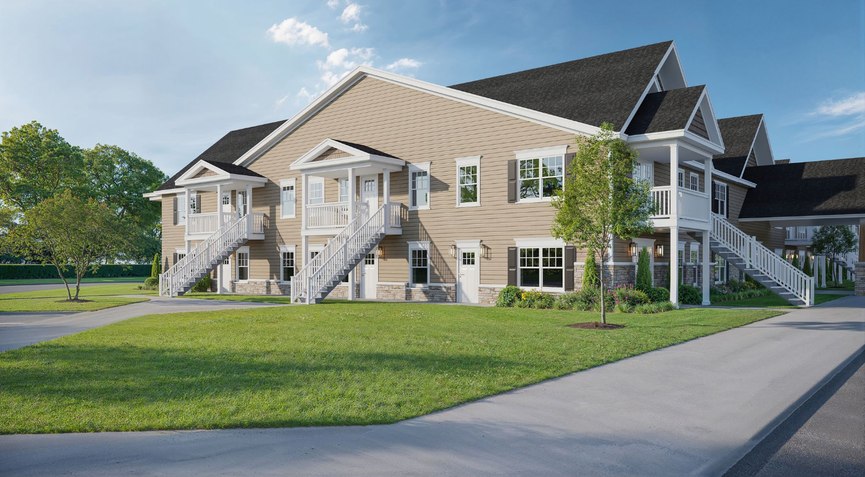

Slide 23
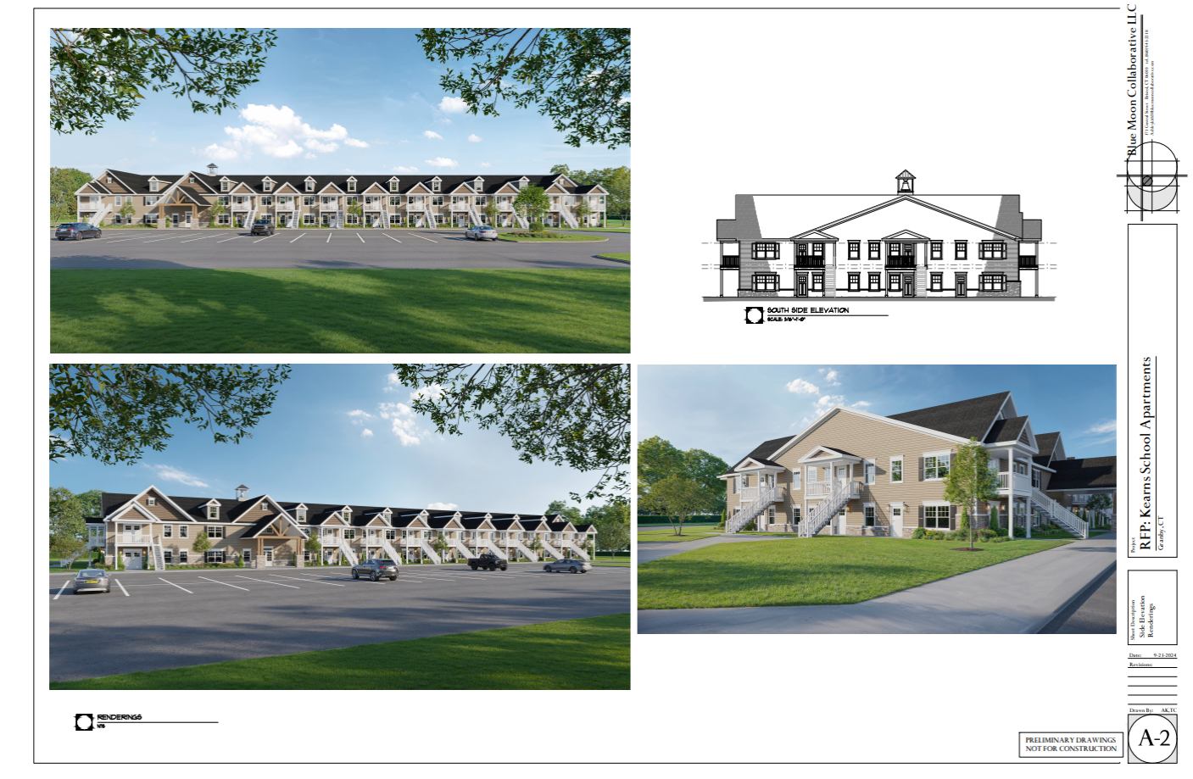

Slide 24
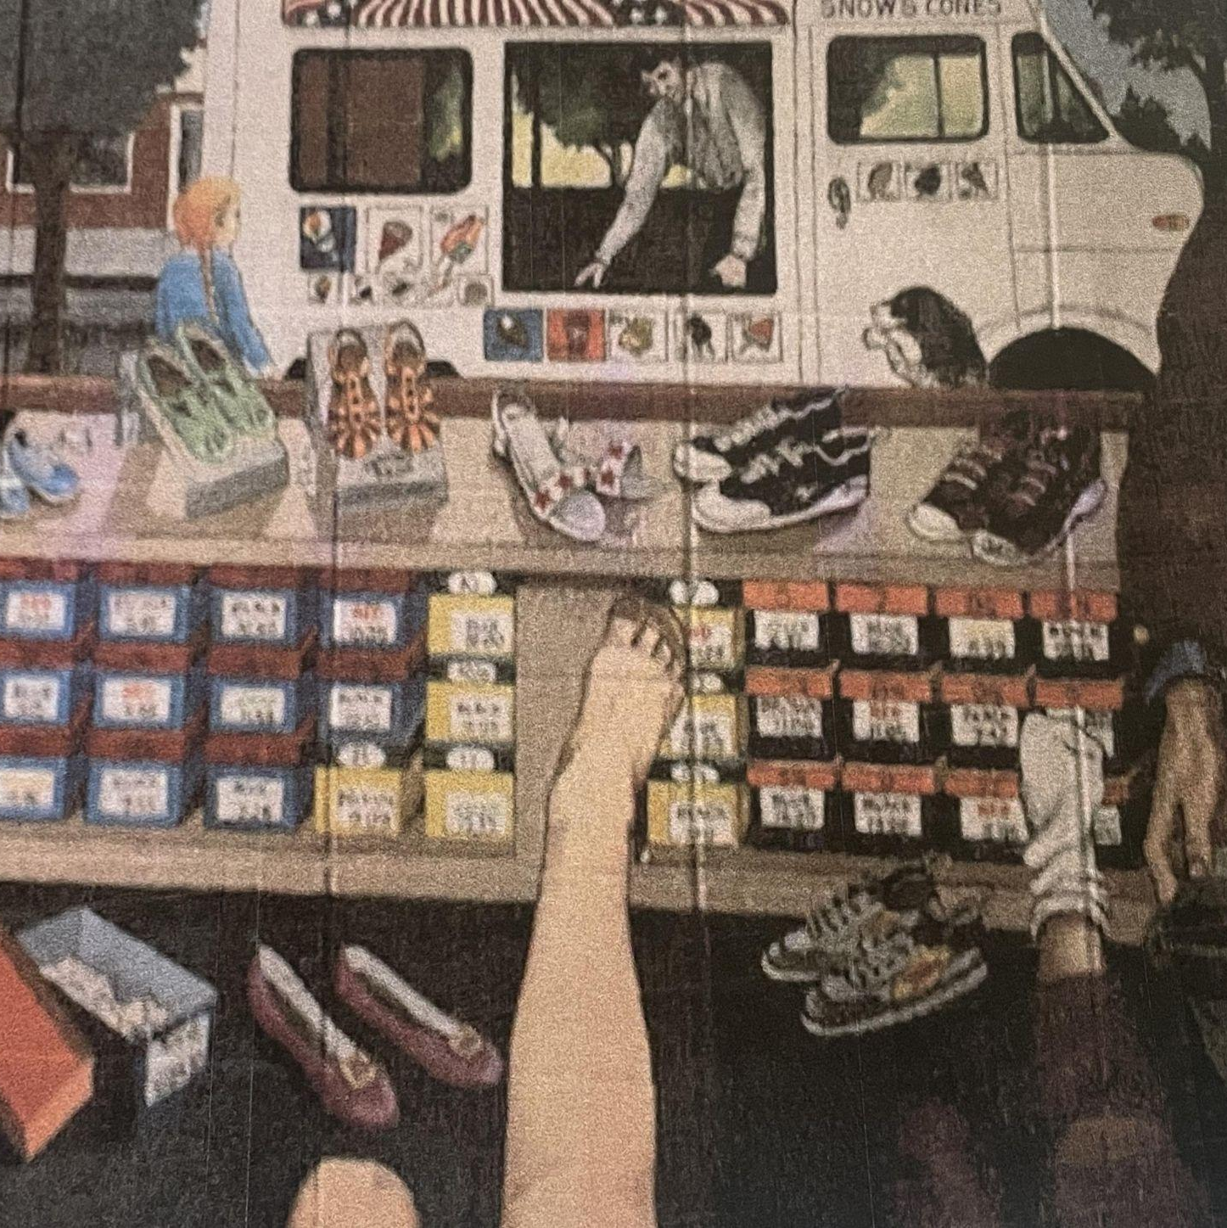
Demolish or Renovate
We want to keep the past and give a second life to the school
Maintaining the building’s existing footprint.
Preserving history & murals.
Addition of school bell.
Theme of the property will be school in every way.

Slide 25
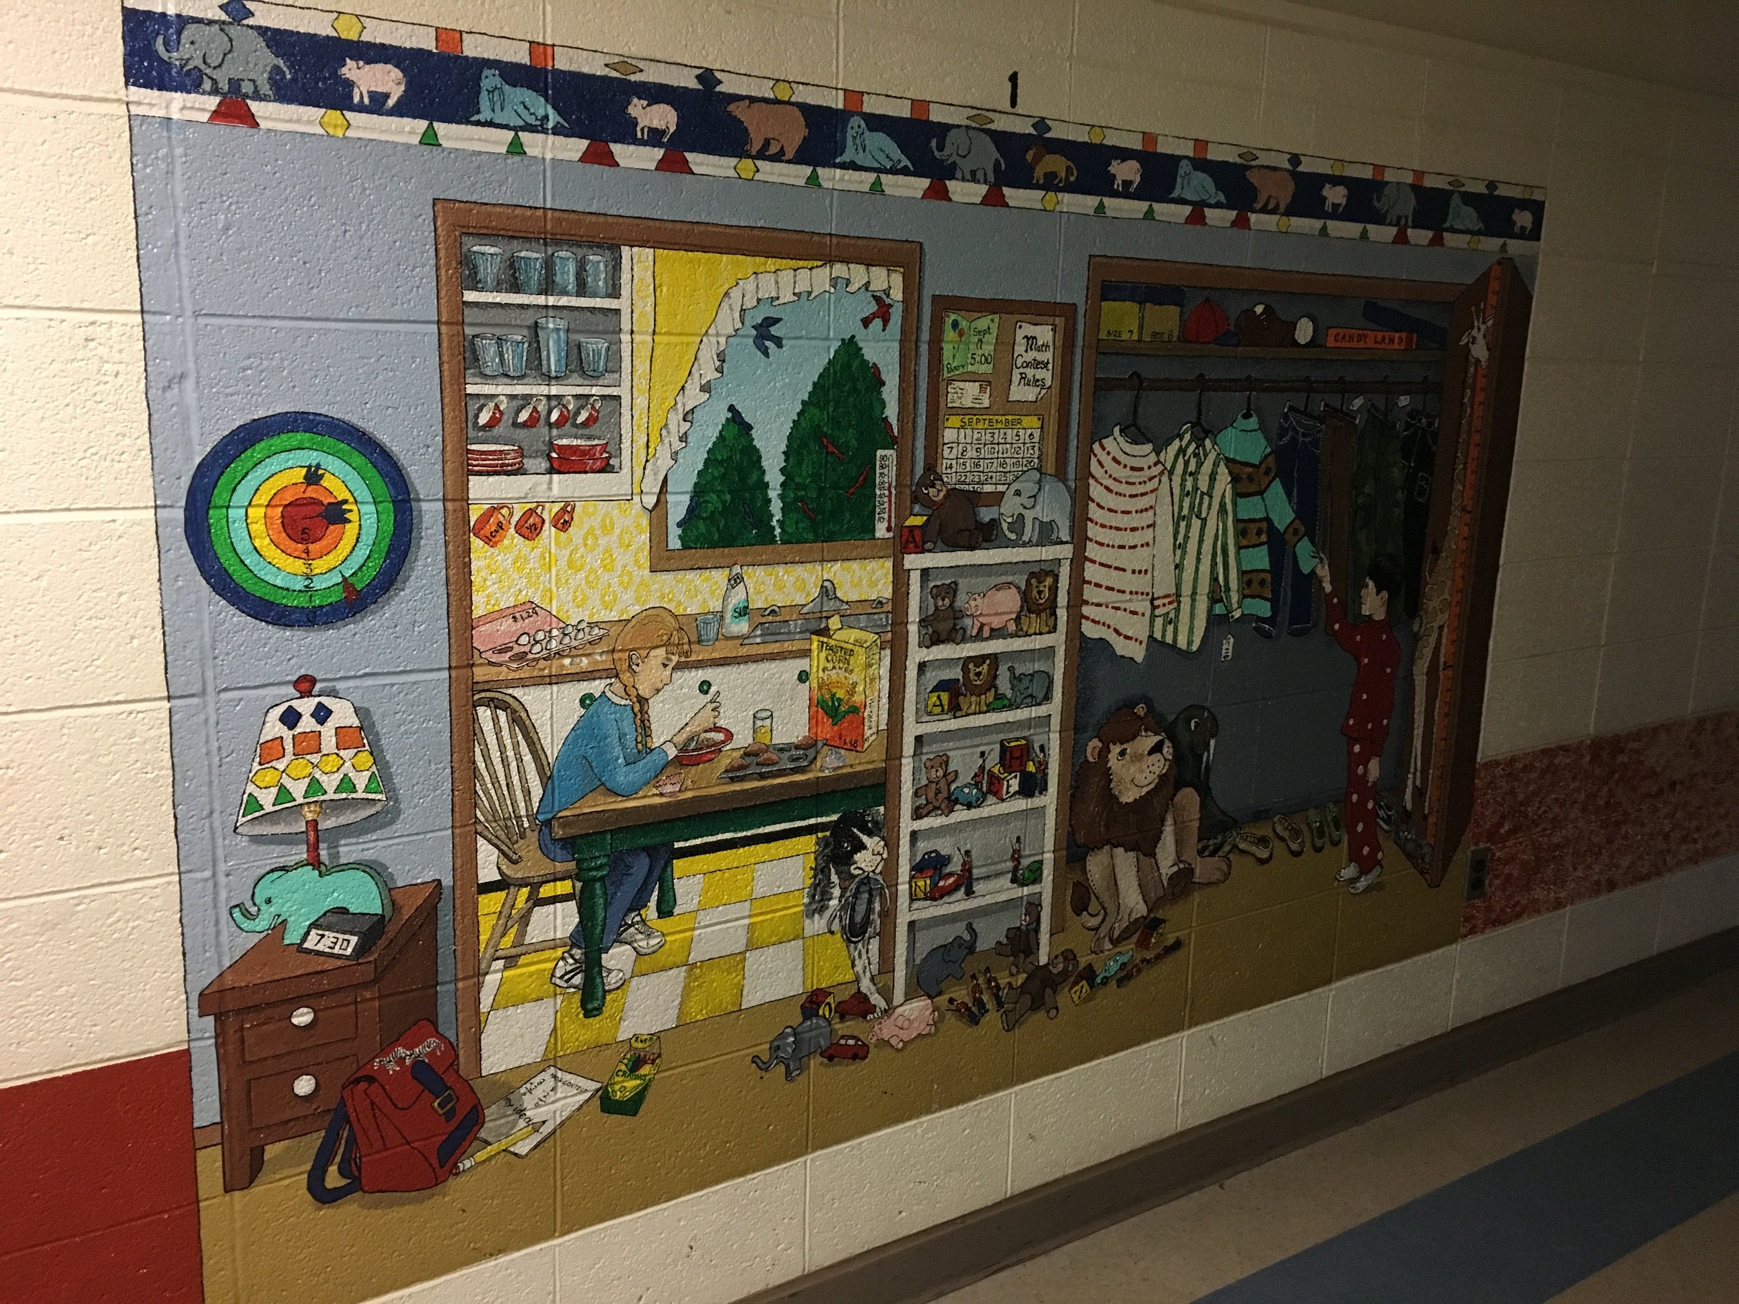
Showcase Campus Art

Slide 26
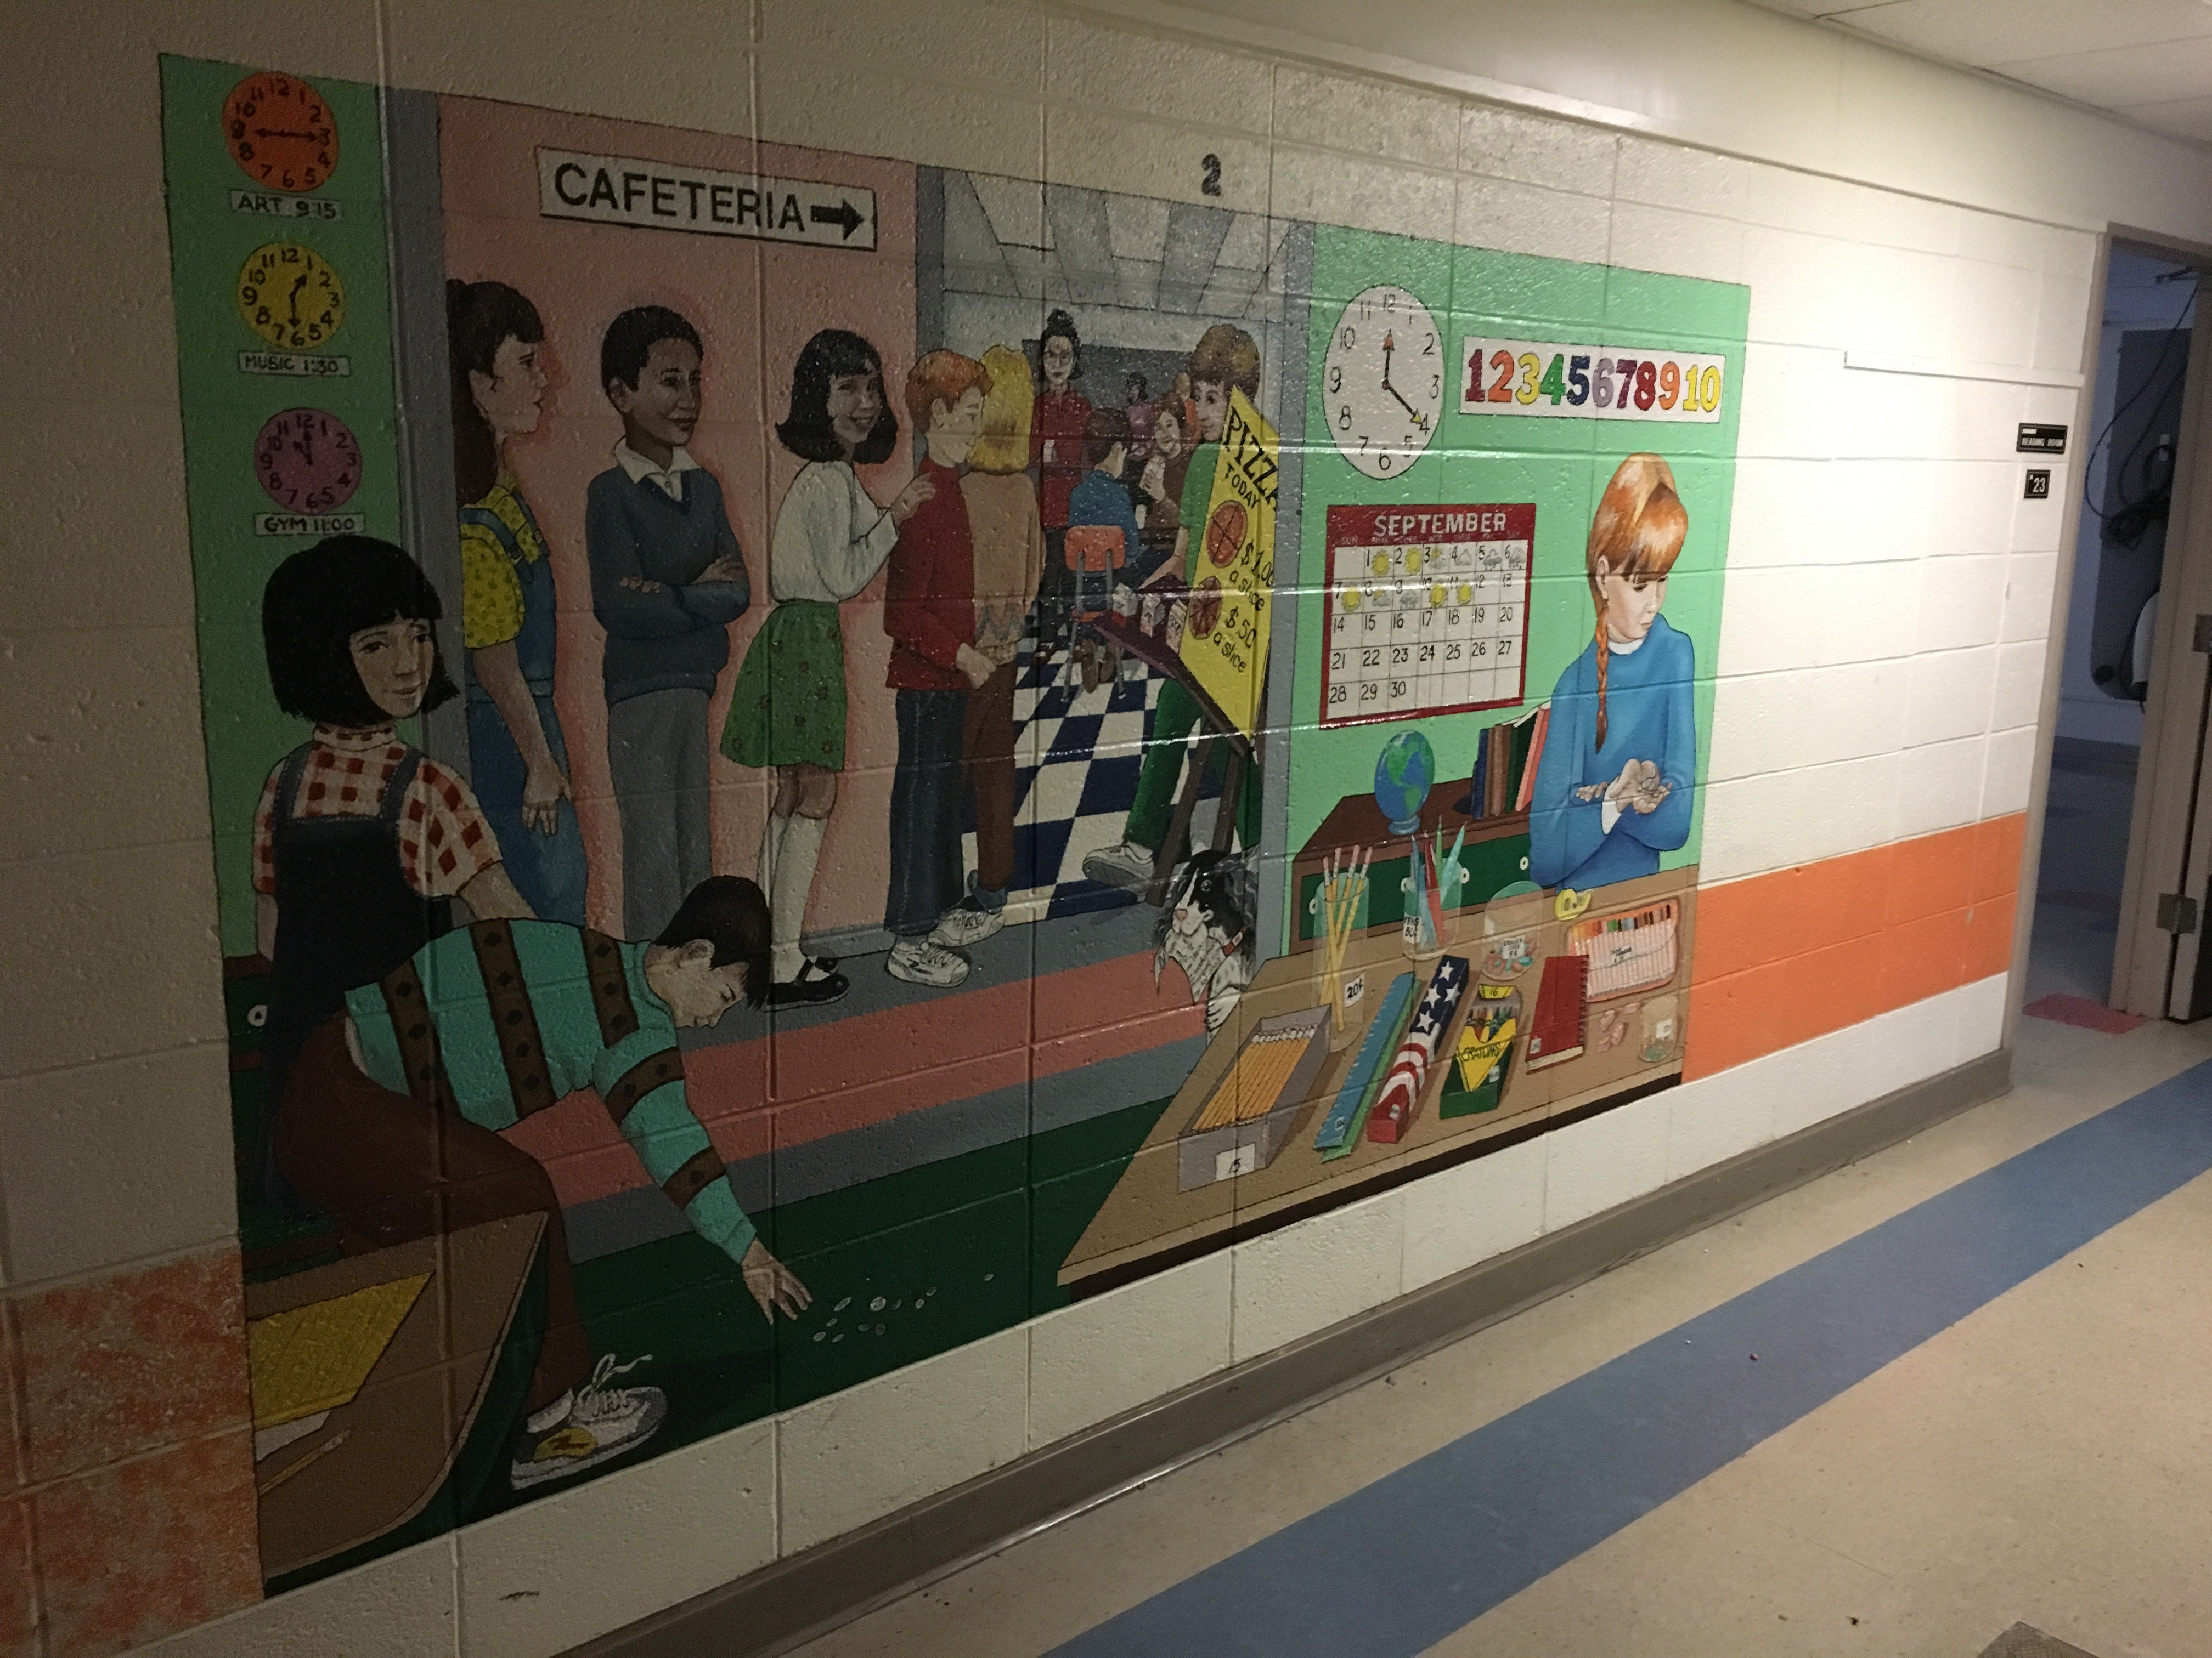
Showcase Campus Art

Slide 27
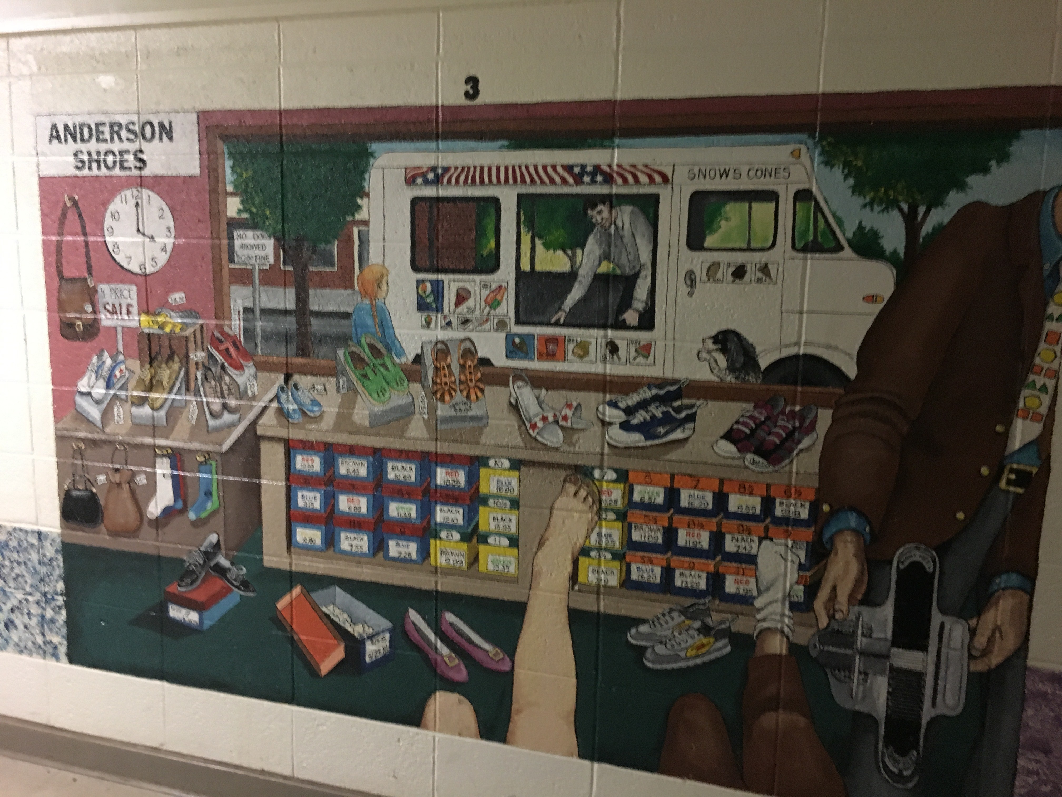
Showcase Campus Art

Slide 28
Kearns School Vision
Storage Units and Charging Stations
Ponds, Alluring Gardens, and Walking Trails
Pickleball Courts, Dog Park
Complete transformation to a modern 66+ unit active adult living community, offering luxurious amenities at an affordable price.
Our affordable units will contribute towards increasing the towns 3.28% affordable units currently on the books. We're offering 40% affordable.
Notes:
Our Kearns School vision includes a Complete transformation into a modern 60 unit adult living community, that commemorates the schools history, while offering luxurious amenities. Our community will include:
Storage units and charging stations, to support a eco friendly and modern lifestyle.
Ponds, alluring gardens, and walking trails to foster an active society.
And pickleball courts to promote community.

Slide 29
Our Process of Development from vision to completion If we win the proposal.
Open Forum Data Input sessions for all Granby stakeholders - we’ll serve Arethusa Ice Cream to all who attend
We share our vision of the property
We want to hear what people want and we’ll merge community requests into our vision to build the property
We’ve used towns affordable housing plan & community center proposal to develop our vision

Slide 30



Community / Public Events that’ll run once the property is built
Demo Day
Prom Night
Drama Night
Fishing Derby
Art events
  Paint night/Drawing
  Dog & Pet Shows
  Art, School themed throughout building & activities
  Gardening

Slide 31
Community Hub Vision
We’re not just going to build apartments, it’ll be a lifestyle campus within the town.
2 story, modern, efficient, green buildings
Keep existing structures and add to them, minimal environmental impact
When done, 60 to 66 units
Complete transformation into a signature campus for Granby's senior living.
No step entries and elevator for accessibility
Community room (Bear Den), community gardens, and pickleball courts

Slide 32
Community Hub Vision
We’re not just going to build apartments, it’ll be a lifestyle campus within the town.
Smart home technology and fall detection systems
Raised electrical outlets for less bending for our seniors
Fire Alarm & Security Systems
Toggle switches for all light switches
Levered Doorknobs for easy turning
Additional lighting throughout
Grab bars, high toilets, wide hallways
Carbon neutral
  Solar powered heat pumps
  Additional energy efficient measures
Handicapped Adaptable Bathrooms

Slide 33
Kearns School Apartments Thematic Vision
School, college throughout
It’s a campus for the town of Granby
Each building will have a Dorm name
Community votes will name the dorms
Bell Tower will be a signature piece
Office will be “Headmasters Office”
Medical area = “Nurses Office”
Maintenance = “Custodians”
Barns = “Agricultural Buildings”
Sporting events “Athletic Director”
Everything will be themed school/college and we’ll use the Bear as the mascot, kids and adults are Bears in this campus

Slide 34
Kearns School Apartments Thematic Vision of
School, college throughout
Existing Library will become the Bears Den, a community space for residents to have birthday parties, baby showers, family get togethers, bear bingo, card night, pot-luck meals, community games, etc.

Slide 35
Campus Resident Age Restrictions & Financials
We’re going to follow the age restriction from HUD over 55 act.
60-66 units
40% will be affordable at 80% AMI
3% of the 40% will be at 60% AMI
We hope many of our residents went to school here and can become a bear again

Slide 36
Occupants and Financials
Unit | Square Feet | Affordable Rent | Market Rent
4, 2 bedroom units | 1492 | $1877/m | $3000/m
3, 1 bedroom units | 1453 | $1668/m | $2200/m
17, 2 bedroom units | 1095 | $1877/m | $2700/m
7, 1 bedroom units | 1097 | $1668/m | $1950/m
24, 1 bedroom units | 721-742 | $1668/m | $1950/m
2 studio unit | 459 | $876/m | $1000/m
4, 2 bedroom units | 1331-1334 | $1877/m | $2700/m
Notes:
Specify age or mixed ages proposed

Slide 37
Occupants & Financials Continued
Unit Type | # of Units | # of Bedrooms | Rent
Affordable/Workforce Housing 80% AMI | 14 | 2 | $1,877.00
Affordable/Workforce Housing 80% AMI Affordable/Workplace Housing 60% AMI | 10 2 | 1 2 | $1,668.00 $876.00
Market Rate 1 bedroom | 21 | 1 | $1,850.00
Market Rate 2 bedroom | 11 | 2 | $2,600.00
Retail Housing Market 2 bedroom gym | 4 | 2 | $3,000.00
Notes:
Specify age or mixed ages proposed

Slide 38
Operations
Tim Bobroske construction handles all of their own property maintenance headed by Lynne Bobroske
This includes mowing, landscaping, plowing, rubbish, safety features, lighting, resident maintenance, etc.

Slide 39
Support Services
We’ll support local people to do workshops to our residents.
We’ll support events on campus for our residents and the towns people in general
We will not offer meals or health care on a campus level.

Slide 40

West Side of Property
We’d ask that the town allow for the same building density on the west side of the property that we’ll have for the campus project today on the east side of the property. Assuming we can get the pond and our vision approved, whatever land on the west side that isn’t wetlands we’d like to have an opportunity to expand the campus on that land at a later date to give the town of Granby more senior housing, and more affordable housing as the towns needs expand.
This piece of the property should have a completely separate deed once we’re through the town approval process but would carry the same tax advantages.

Slide 41
Timing of Campus Build
We expect the permitting and processing to begin immediately. We would expect site environmental cleanup simultaneously to keep the project timely. Our expectation is we're through the initial phase in calendar year 2025.
We expect site work & Demo phase of the process to take 3-4 months, once complete building renovations and additions should take 10-14 months.
We anticipate the full project to take 18-24 months to complete once we’ve acquired all of the necessary permits and permissions. Our budget for the overall project is $10 million dollars.

Slide 42
Financial Metrics
Proposed $25,000.00 purchase price of the property from the town.
We’re experienced in funding like projects with a combination of local banks, CHFA, Eversource, HUD, Federal Home Loan Bank, CT DOH and capital markets instruments through CHFA tax exempt and municipal bonds.
We expect an overall spend of $9,570,000-9,989,000.00. The funding will be a combination of the above plus our personal investments. The monthly payments we expect to be $90,285/m with a maximum assumed rate of 8% on debt service. We’d expect income to be $138,812/m at the 60/40 AMI split discussed above.

Slide 43
Town Assistance
We’d ask the town for the following financial assistance from the town
$25,000 proposed purchase price
Open dialogue on building permit fee to get a fixed dollar fee rather than a percentage of actual costs
No sewer/water connection charges as they’re already connected
Tax abatement of 0 taxes in years 1,2 & 3, 20k/yr for years 4-14 then market rate taxes thereafter
Site cleanup so we're buying a environmentally clean canvas.

Slide 44
Town Assistance
Town of Granby would have to create a zoning regulation that will allow for multi family housing in R-30 to the campus project. New Hartford did this as an overlay zone for us.
We’ll work closely with the town personnel to get through the permitting/development and construction phases. We’ll handle all operations once the buildings are build and we have CO’s.

Slide 45
Financial metrics
Market Rates
Affordable Housing
40 Units will be priced at market rates.
26 Units will be available as affordable housing using 60-80% AMI targets
40%
60%

Slide 46
Town Assistance
Property Tax Waiver for years 1, 2 & 3
Fixed tax bill of $20,000 annually in years 4-10
$30,000 in years 11-15, market rate therafter
Phase 1 and hazmat completed by the town prior to transfer
At time of transfer the property is free of any contamination
The property is green lighted by environmental perspective

Slide 47
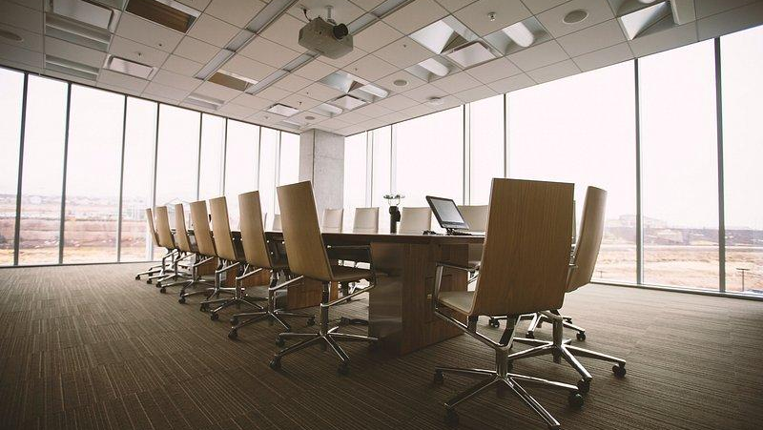
Questions?

